Slide 1
Multiplexing

Slide 2
Introduction
Under the simplest conditions, a medium can carry only one signal at any moment in time.
For multiple signals to share one medium, the medium must somehow be divided

Slide 3
Why multiplexing?
The communication media usually have much higher bandwidth
On the other hand individual users have lesser data to send. And as a consequence the two communicating stations do not utilize the full capacity of a data link.

Slide 4
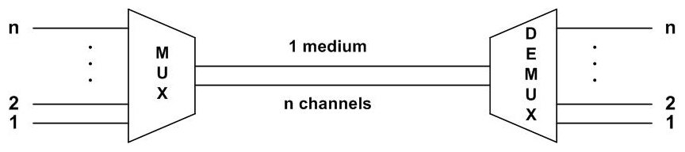

Slide 5
Multiplexing techniques can be categorized into the following three types:
Frequency-division multiplexing (FDM): It is most popular and is used extensively in radio and TV transmission. Here the frequency spectrum is divided into several logical channels, giving each user exclusive possession of a particular frequency band.

Slide 6
Time-division Multiplexing (TDM): It is also called synchronous TDM, which is commonly used for multiplexing digitized voice stream. The users take turns using the entire channel for short burst of time.
Statistical TDM: This is also called asynchronous TDM, which simply improves on the efficiency of synchronous TDM.

Slide 7
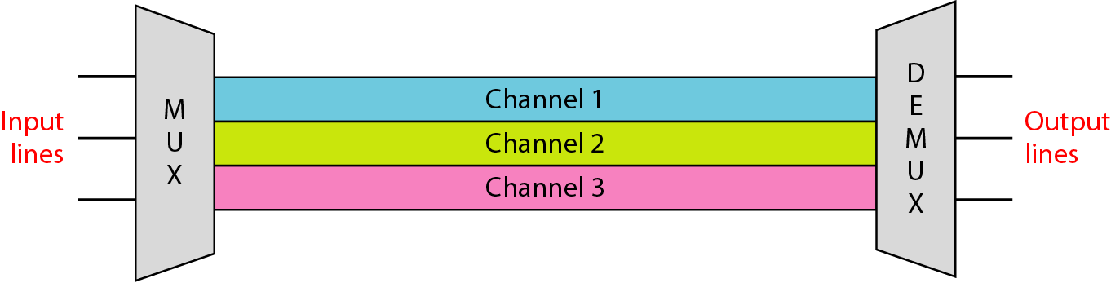
Frequency-Division Multiplexing

Slide 8
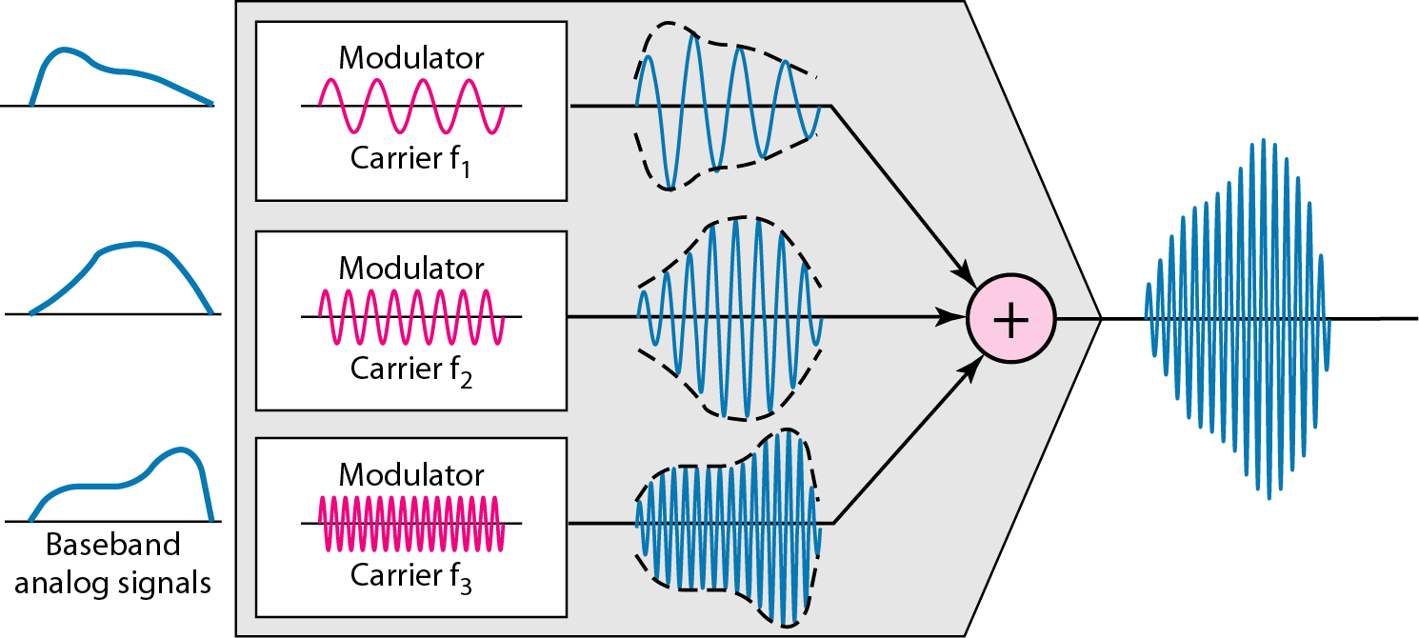
FDM is an analog multiplexing technique that combines analog signals.

Slide 9
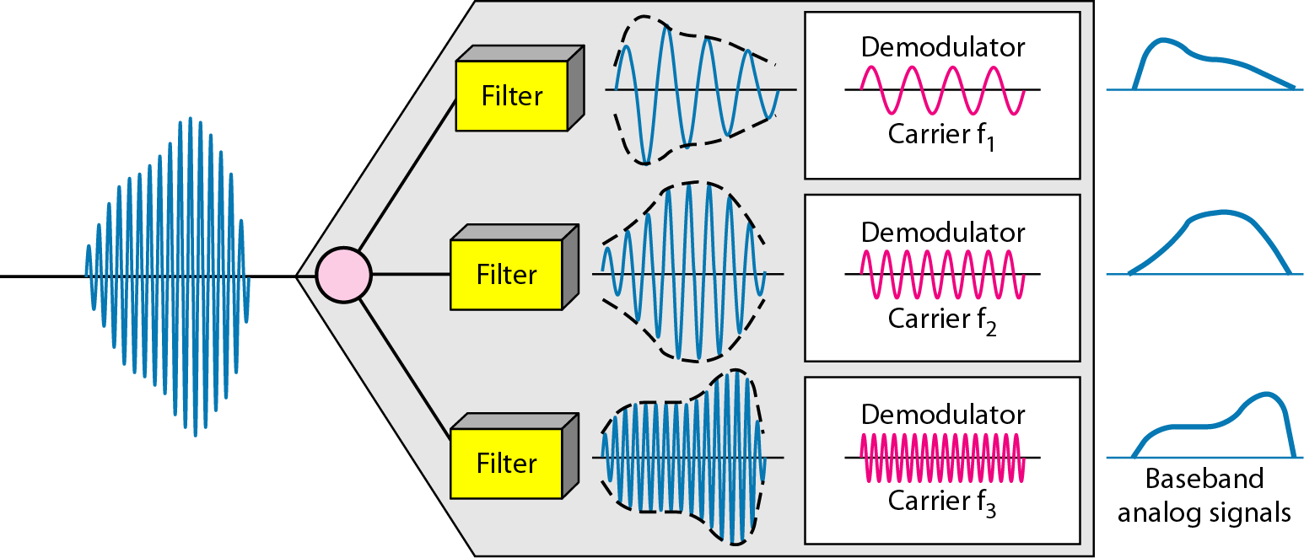

Slide 10
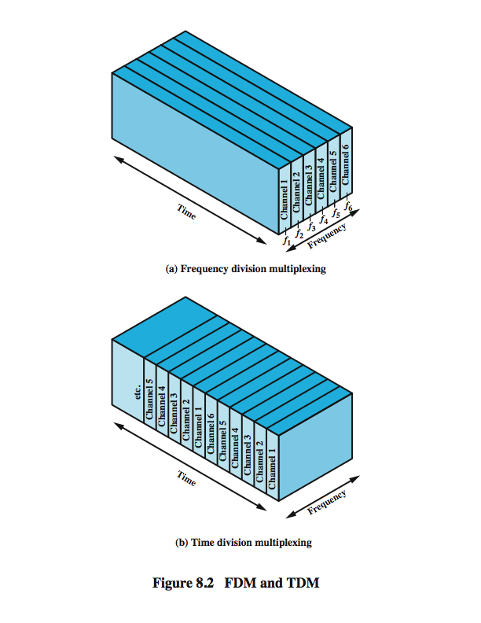
Frequency Division Multiplexing
Notes:
Frequency division multiplexing can be used with analog signals. A number of signals are carried simultaneously on the same medium by allocating to each signal a different frequency band. FDM is possible when the useful bandwidth of the transmission medium exceeds the required bandwidth of signals to be transmitted. A number of signals can be carried simultaneously if each signal is modulated onto a different carrier frequency and the carrier frequencies are sufficiently separated that the bandwidths of the signals do not significantly overlap. A general case of FDM is shown in Stallings DCC8e Figure 8.2a. Six signal sources are fed into a multiplexer, which modulates each signal onto a different frequency (f₁, …, f₆). Each modulated signal requires a certain bandwidth centered on its carrier frequency, referred to as a channel. To prevent interference, the channels are separated by guard bands, which are unused portions of the spectrum. The composite signal transmitted across the medium is analog. Note, however, that the input signals may be either digital or analog. In the case of digital input, the input signals must be passed through modems to be converted to analog. In either case, each input analog signal must then be modulated to move it to the appropriate frequency band.

Slide 11
Basic approach is to divide the available bandwidth of a single physical medium into a number of smaller, independent frequency channels.
Using modulation, independent message signals are translated into different frequency bands.
All the modulated signals are combined to form a composite signal for transmission.
The carriers used to modulate the individual message signals are called sub-carriers,

Slide 12
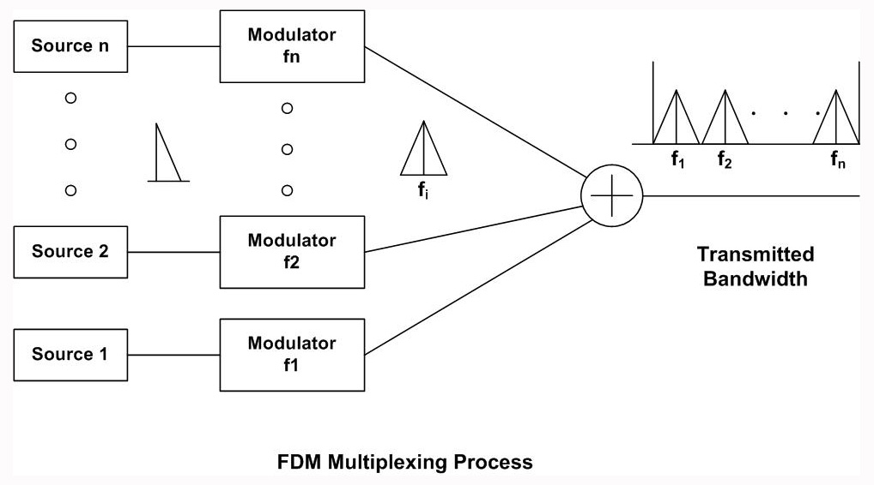

Slide 13
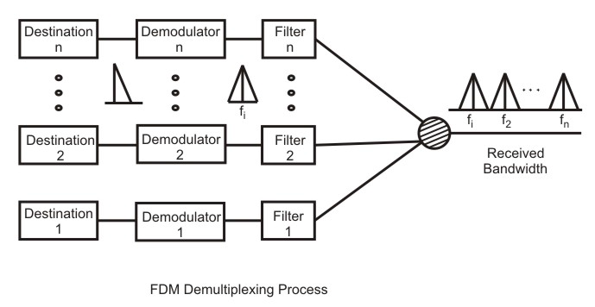

Slide 14
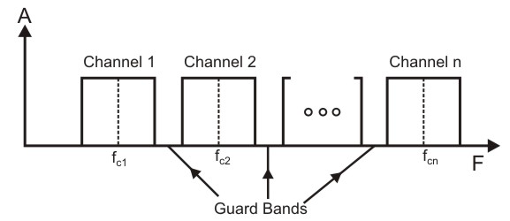
If the channels are very close to one other, it leads to inter-channel cross talk.
Channels must be separated by strips of unused bandwidth to prevent inter-channel cross talk.
These unused channels between each successive channel are known as guard bands

Slide 15
Assume that a voice channel occupies a bandwidth of 4 kHz. We need to combine three voice channels into a link with a bandwidth of 12 kHz, from 20 to 32 kHz. Show the configuration, using the frequency domain. Assume there are no guard bands.
Solution
We shift (modulate) each of the three voice channels to a different bandwidth, as shown in Figure. We use the 20- to 24-kHz bandwidth for the first channel, the 24- to 28-kHz bandwidth for the second channel, and the 28- to 32-kHz bandwidth for the third one. Then we combine them as shown in Figure.

Slide 16
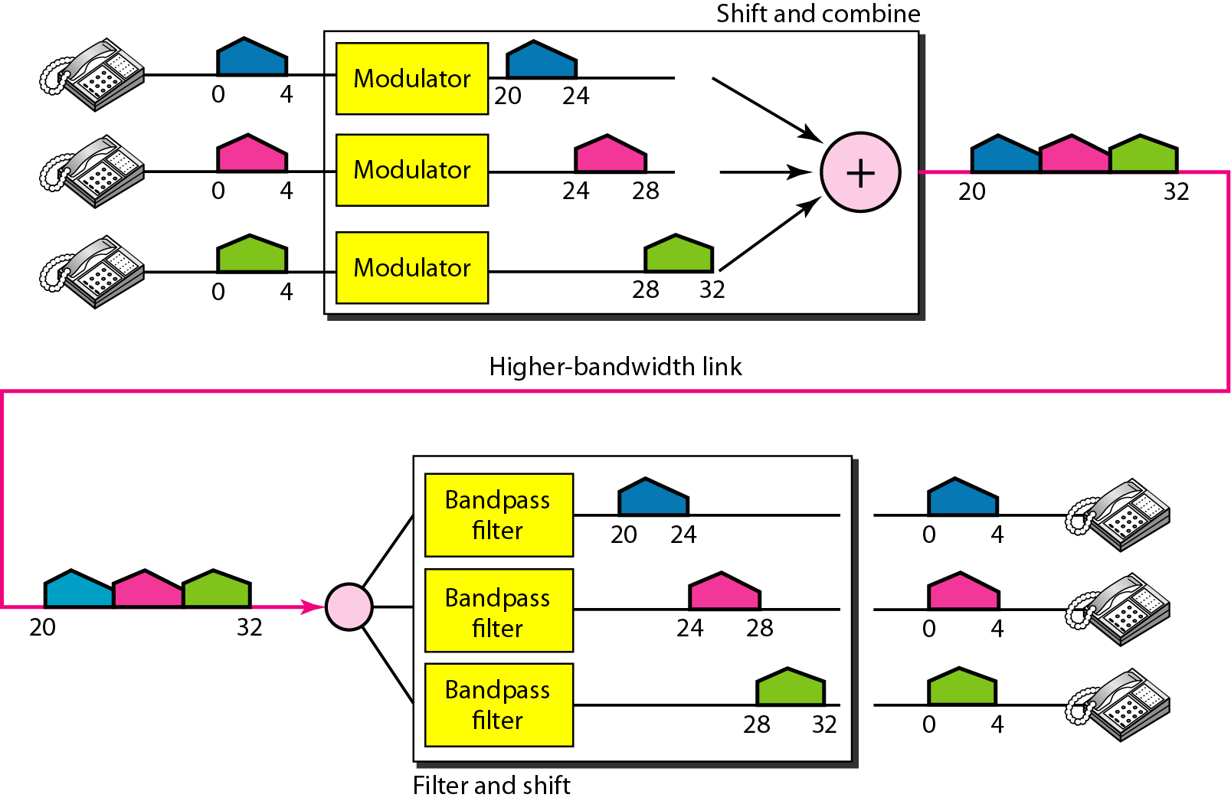

Slide 17
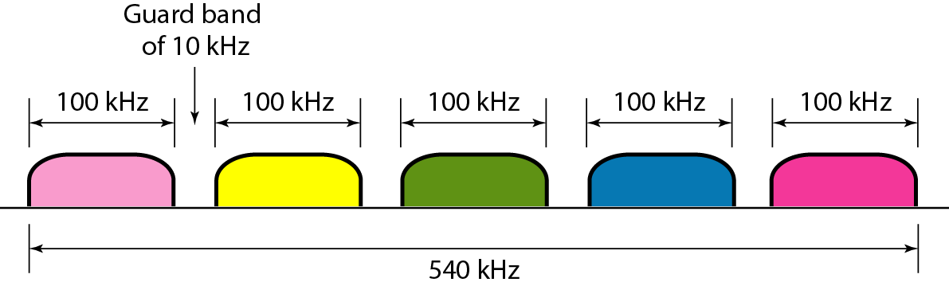
Five channels, each with a 100-kHz bandwidth, are to be multiplexed together. What is the minimum bandwidth of the link if there is a need for a guard band of 10 kHz between the channels to prevent interference?
Solution
For five channels, we need at least four guard bands. This means that the required bandwidth is at least
5 × 100 + 4 × 10 = 540 kHz,

Slide 18
Wavelength-Division Multiplexing
Wavelength-division multiplexing (WDM) is conceptually same as the FDM, except that the multiplexing and demultiplexing involves light signals transmitted through fibre-optic channels.
The idea is the same: we are combining different frequency signals.
However, the difference is that the frequencies are very high.

Slide 19
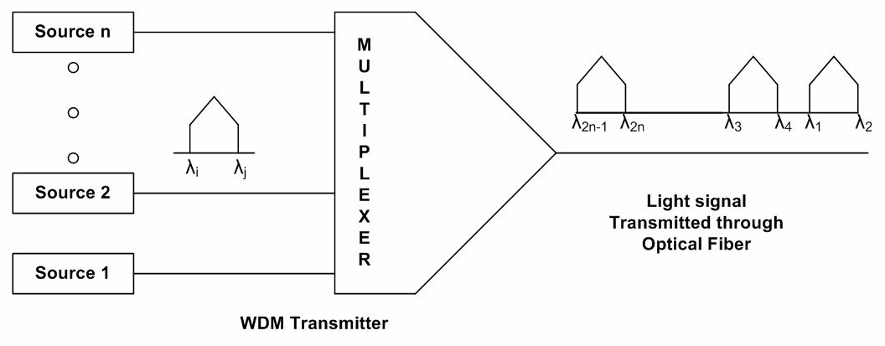

Slide 20
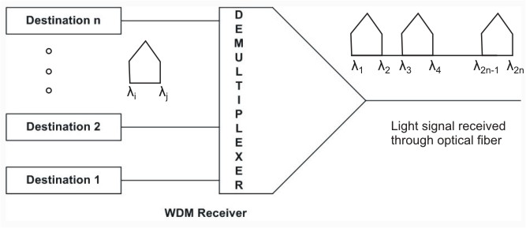

Slide 21
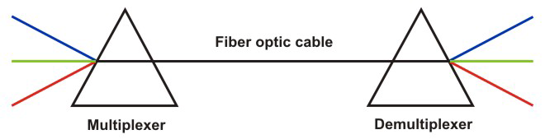
From the basic knowledge of physics we know that light signal is bent by different amount based on the angle of incidence and wavelength of light as shown by different colours in the figure.
One prism performs the role of a multiplexer by combining lights having different frequencies from different sources.
The composite signal can be transmitted through an optical fibre cable over long distances, if required.
At the other end of the optical fibre cable the composite signal is applied to another prism to do the reverse operation, the function of a demultiplexer.

Slide 22
Time-Division Multiplexing
In frequency division multiplexing, all signals operate at the same time with different frequencies, but in Time-division multiplexing all signals operate with same frequency at different times.

Slide 23
Synchronous Time Division Multiplexing
The multiplexor accepts input from attached devices in a round-robin fashion and transmit the data in a never ending pattern.
Synchronous TDM is called synchronous because the time slots are preassigned to sources and fixed.
The sequence of slots dedicated to one source, from frame to frame, is called a channel.
The slot length equals the transmitter buffer length, typically a bit or a byte (character).
The time slots for each source are transmitted whether or not the source has data to send
it is possible for a synchronous TDM device to handle sources of different data rates. For example, the slowest input device could be assigned one slot per cycle, while faster devices are assigned multiple slots per cycle.

Slide 24
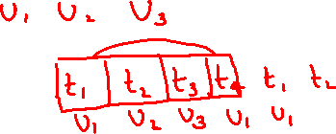
Synchronous Time Division Multiplexing
Notes:
Synchronous time division multiplexing can be used with digital signals or analog signals carrying digital data. In this form of multiplexing, data from various sources are carried in repetitive frames. Each frame consists of a set of time slots, and each source is assigned one or more time slots per frame. The effect is to interleave bits of data from the various sources. The interleaving can be at the bit level or in blocks of bytes or larger quantities. For example, the multiplexer in Stallings DCC8e Figure 8.2b has six inputs that might each be, say, 9.6 kbps. A single line with a capacity of at least 57.6 kbps (plus overhead capacity) could accommodate all six sources.
Synchronous TDM is called synchronous not because synchronous transmission is used, but because the time slots are preassigned to sources and fixed. The time slots for each source are transmitted whether or not the source has data to send.

Slide 25
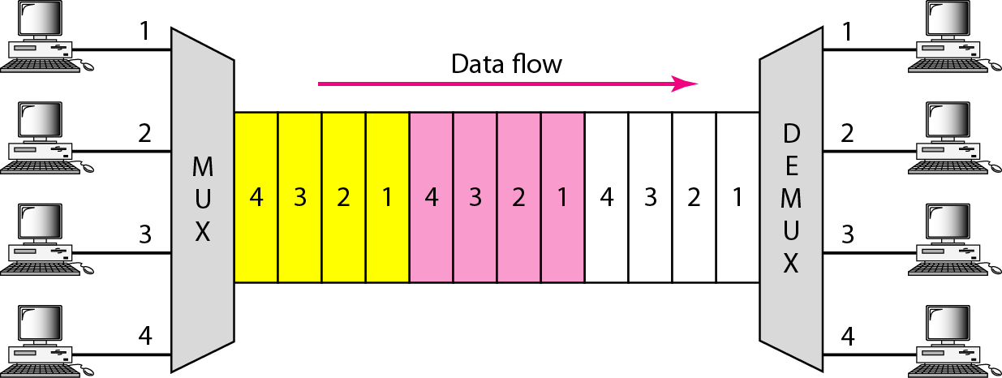
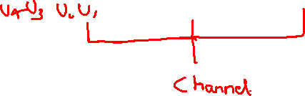

Slide 26
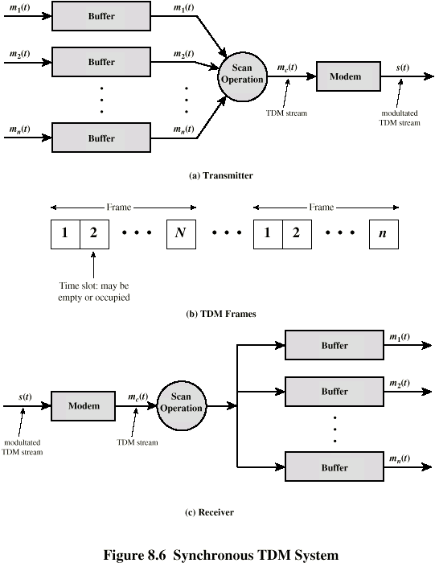

Slide 27
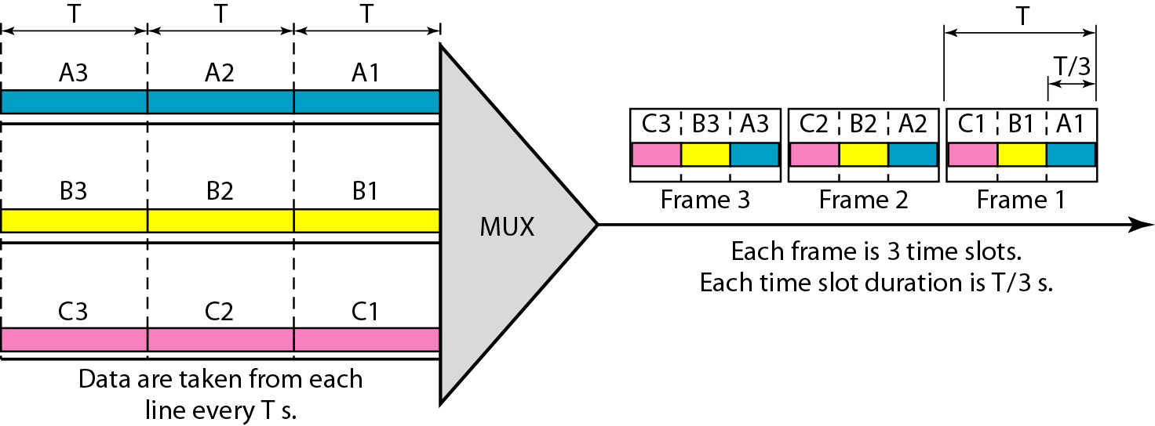
Synchronous time-division multiplexing
In synchronous TDM, each input connection has an allotment in the output even if it is not sending data.
In synchronous TDM, the data rate of the link is n times faster, and the unit duration is n times shorter.

Slide 28
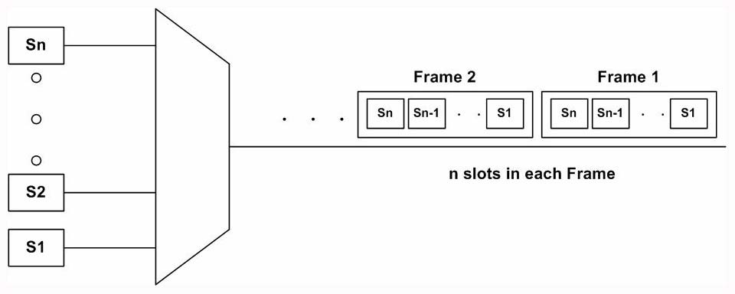

Slide 29
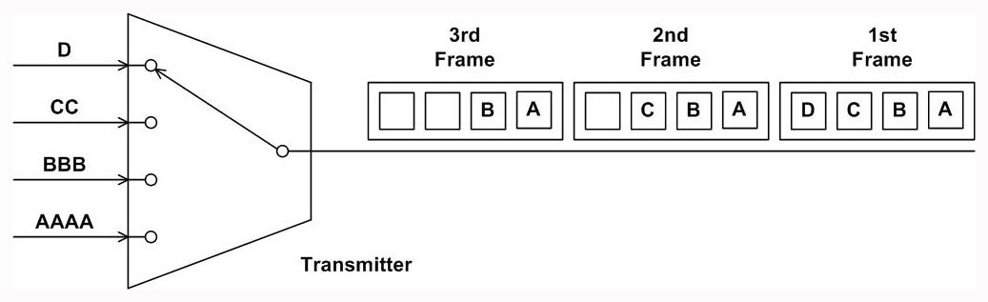
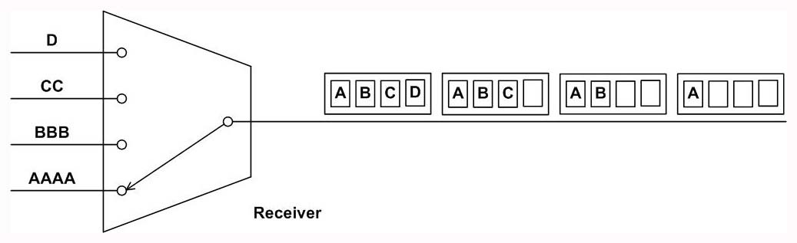


Slide 30
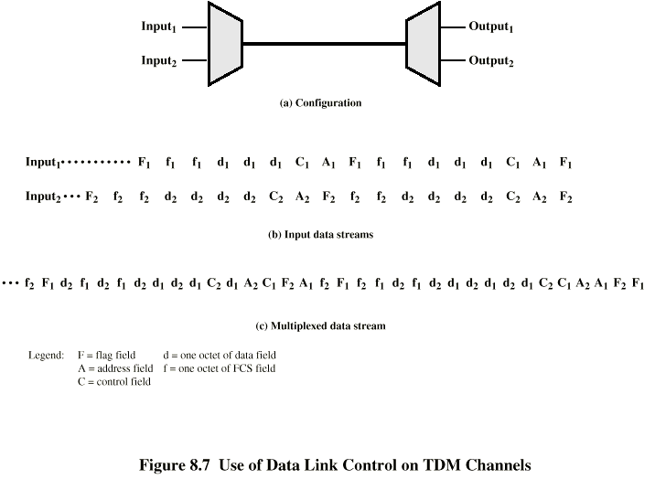
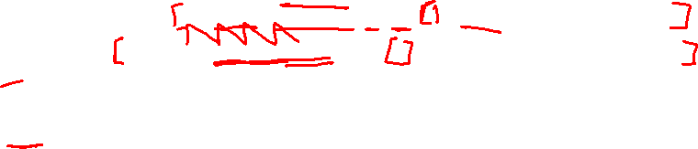
Data link control on TDM channel

Slide 31
We assume two data sources, each using HDLC.
One is transmitting a stream of HDLC frames containing three octets of data each
the other is transmitting HDLC frames containing four octets of data.
The octets of the HDLC frames from the two sources are shuffled together for transmission over the multiplexed line.
The FCS is not in one piece. However, the pieces are reassembled correctly before they are seen by the device on the other end of the HDLC protocol.

Slide 32

Framing
Some means is needed to assure frame synchronization.
Important to maintain framing synchronization because, if the source and destination are out of step, data on all channels are lost.
The most common mechanism for framing is known as added-digit framing.
In this scheme, typically, one control bit is added to each TDM frame.
An identifiable pattern of bits, from frame to frame, is used as a “control channel.”

Slide 33
Thus, to synchronize, a receiver compares the incoming bits of one frame position to the expected pattern. If the pattern does not match, successive bit positions are searched until the pattern persists over multiple frames

Slide 34
Statistical Time Division Multiplexing
A statistical multiplexor transmits only the data from active workstations.
If a workstation is not active, no space is wasted on the multiplexed stream.
A statistical multiplexor accepts the incoming data streams and creates a frame containing only the data to be transmitted.

Slide 35
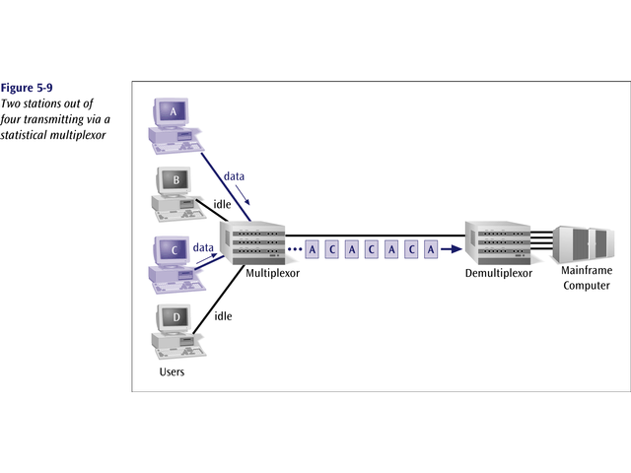


Slide 36
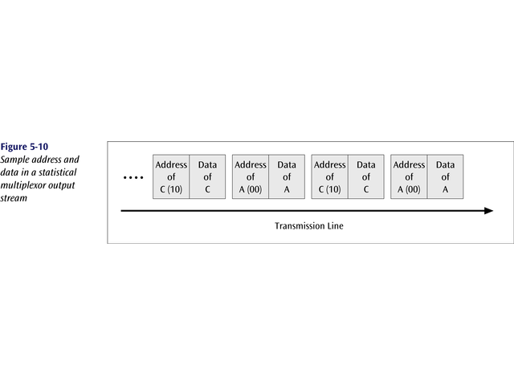
To identify each piece of data, an address is included

Slide 37
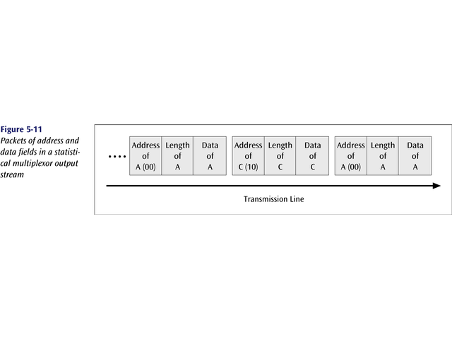
If the data is of variable size, a length is also included

Slide 38
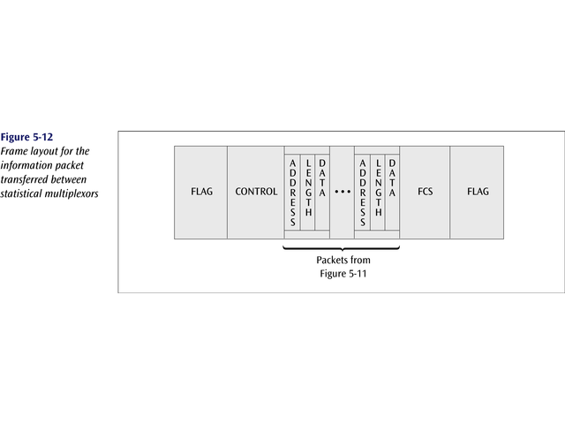
More precisely, the transmitted frame contains a collection of data groups.

Slide 39
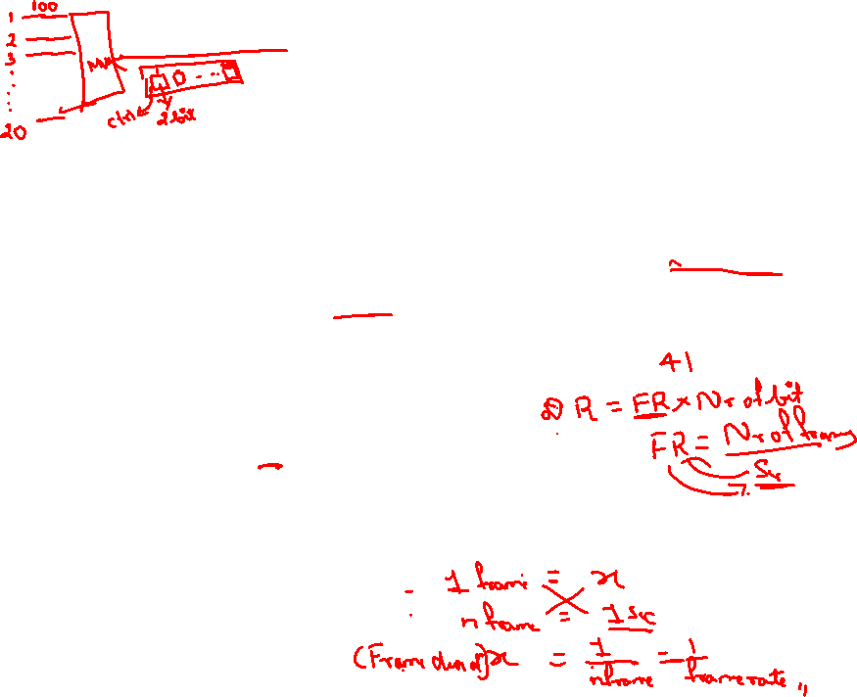
Example
We need to use synchronous TDM and combine 20 digital sources, each of 100 Kbps. Each output slot carries 2 bit from each digital source, but one extra bit is added to each frame for synchronization. Answer the following questions:
a. What is the size of an output frame in bits?
b. What is the output frame rate?
c. What is the duration of an output frame?
d. What is the output data rate?
e. What is the efficiency of the system (ratio of useful bits to the total bits).

Slide 40
Each output frame carries 2 bits from each source plus one extra bit for synchronization.
Frame size = 20 × 2 + 1 = 41 bits.
Each frame carries 2 bit from each source. Frame rate = 100,000/2 = 50,000 frames/s.
Frame duration = 1 /(frame rate) = 1 /50,000 = 20 μs.
Data rate = (50,000 frames/s) × (41 bits/frame) = 2.05 Mbps.
In each frame 40 bits out of 41 are useful. Efficiency = 40/41= 97.5%.

Slide 41
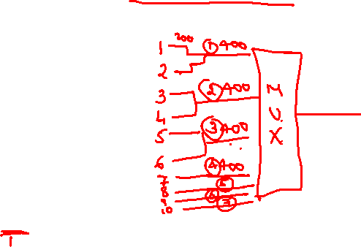
Example
Ten sources, six with a bit rate of 200 kbps and four with a bit rate of 400 kbps are to be combined using TDM with no synchronizing bits. Answer the following questions about the final stage of the multiplexing:
What is the size of a frame in bits?
What is the frame rate?
What is the duration of a frame?
What is the data rate?
[Each output slot carries 1 bit from each digital source]

Slide 42
We combine six 200-kbps sources into three 400-kbps. Now we have seven 400-kbps channel.
Each output frame carries 1 bit from each of the seven 400-kbps line. Frame size = 7 × 1 = 7 bits.
Each frame carries 1 bit from each 400-kbps source. Frame rate = 400,000 frames/s.
Frame duration = 1 /(frame rate) = 1 /400,000 = 2.5 μs.
Output data rate = (400,000 frames/s) × (7 bits/frame) = 2.8 Mbps. We can also calculate the output data rate as the sum of input data rate because there is no synchronizing bits. Output data rate = 6 × 200 + 4 × 400 = 2.8 Mbps.

Slide 43
Example
Show the contents of the five output frames for a synchronous TDM multiplexer that combines four sources sending the following characters. Note that the characters are sent in the same order that they are typed. The third source is silent.
Source 1 message: HELLO
Source 2 message: HI
Source 3 message:
Source 4 message: BYE

Slide 44
